Slide 1
超越学科界限的认知基础 Transdisciplinary Cognitive Foundation
Image Source: Get your guide
Cybernetics: Control and Communication Week 08
Ben Koo
November 2, 2020

Slide 2
Glossary
Epistemology: How knowledge is acquired (dynamic process)
Ontology: How knowledge is organized (static image of knowledge)
Cybernetics: The control and communication of systems
All ideas can be represented as Kan Extension (Categorical Structures)
These Categorical Structures can be thought of as Partially Ordered Sets(POS)
Category Theory provides a mechanism to reuse information in these POSs
Programming Techniques can compress space/time as new information arises
Think about Memoization, Tail Recursion, Iteration

Slide 3
Prior to today’s lecture
All Knowledge represented by Named Functions
This set of rules can be used recursively to generate an infinite amount of expressions.
Variable
Expression1
Expression2
𝜆
Variable
Expression
( )
Expression

Slide 4
A Rhetoric Lens to see the world
Focus on the relational structures between Names
This set of rules can be used recursively to generate an infinite amount of expressions.
Variable
Expression1
Expression2
𝜆
Variable
Expression
( )
Expression

Slide 5
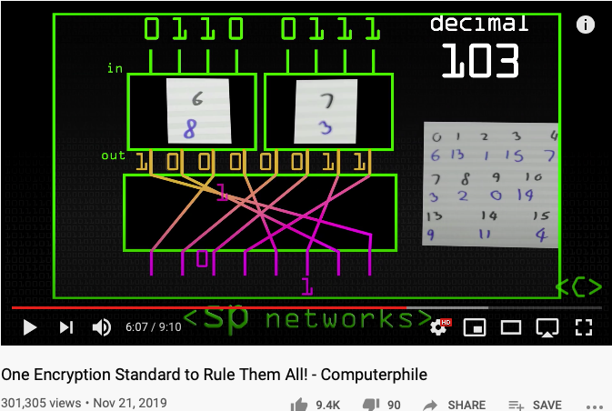
One Encryption Standard to Rule them All
AES replaced IBM’s DES standard because:
A longer (more secure) key length
Faster encryption

Slide 6
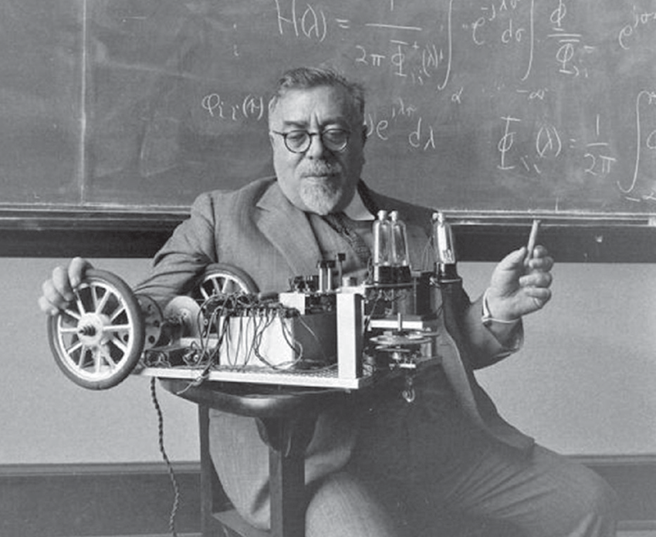
The Dominant Personality behind Cybernetics
Cybernetics:
the science of control and communication in the animal and the machine.
- Norbert Wiener
Image source: Research Gate download Link
Innovation occurs at the boundary of disciplines by competent people.
- Norbert Wiener

Slide 7
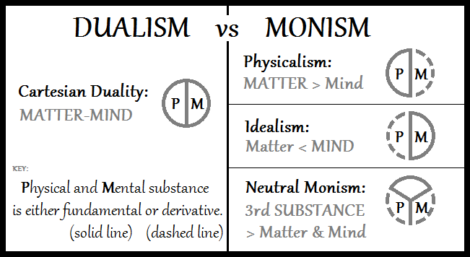
From Monism, Dualism to Cyber-physical Systems
Image Source: Double-aspect Theory on Wikipedia

Slide 8
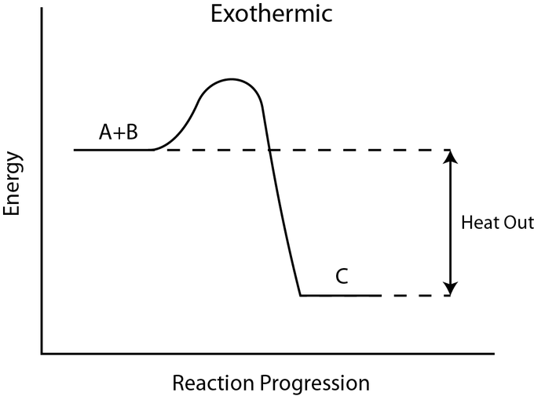
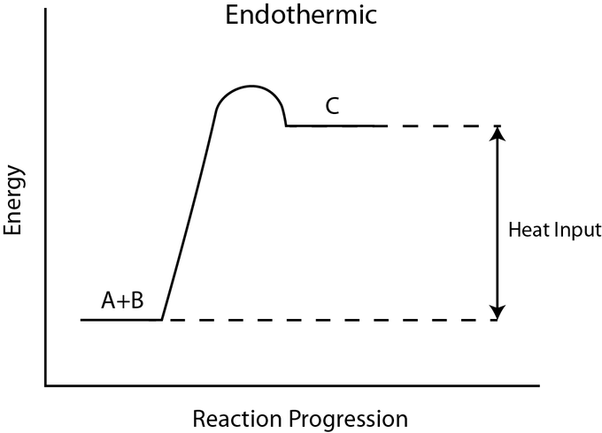
Exothermic and Endothermic
Image Source: exo and endothermic processes on Lumen Learning

Slide 9
Market Dynamics
Bearish Market
Bullish Market
Transaction Costs
Transaction Costs
Image Source: exo and endothermic processes on Lumen Learning

Slide 10
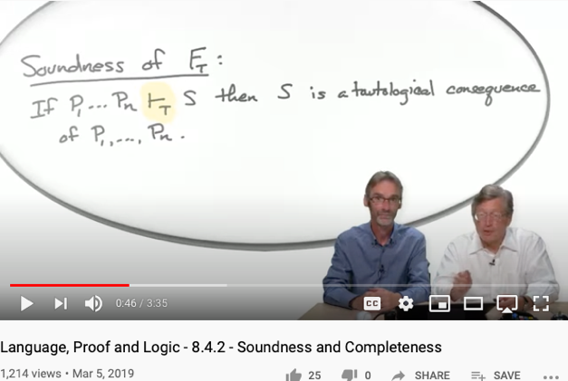
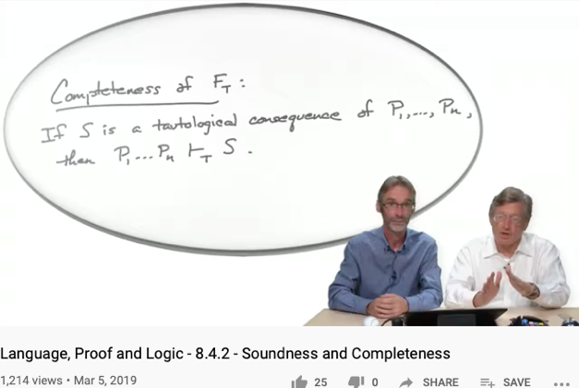
Soundness
Completeness
For engineering/scientific purpose, it is difficult to escape Monism
The unifying notion of “Truth” is the source of Monism
Every provable statement is true
Every true statement is provable
Cited from : Soundness and Completeness: With Precision on news.ycombinator.com
https://youtu.be/3hspKYIn5ds?t=29
https://youtu.be/3hspKYIn5ds?t=162

Slide 11
What is the big deal?
New instrumentation is giving Cybernetics to interact with human at different scales:
Many complex ethical concerns becomes everyday decisions
Consensus must be reached a higher frequencies than before
Choice of vocabulary is affecting the efficiency of search
User Interface Design and the nature of “Scalable Consensus”
Time and Space has been compressed to form new identities
Automated Verification Tools must be applied before any social commitment

Slide 12
Recognizing the Fact
All Knowledge represented by Named Functions
This set of rules can be used recursively to generate an infinite amount of expressions.
Variable
Expression1
Expression2
𝜆
Variable
Expression
( )
Expression

Slide 13
The Universal Structure in 𝜆-Calculus Form
Expression := Contextualized Data (* Known interpretation results, no computation *)
| Goal_Exp Criteria_Exp (* Timeless and Time-based expressions *)
| 𝜆 Input Output_Exp(Input) (* A Computing Process *)
| ( Exception_Handling ) (* Stated boundary conditions/Exceptions *)
This set of rules can be used recursively to generate an infinite amount of expressions.
What
Contextualized data
Goal Expr
Criteria Expr
Why
𝜆
Input
Output Spec
How
( )
Exception Handling

Slide 14

Recursive Structures as a Rewrite System
(Rewrite = Replacement)
Image Source: https://speakerdeck.com/glebec/lambda-calc-talk-frontside-version?slide=66

Slide 15
Monad is an actionable Abstraction
Image Source: https://speakerdeck.com/glebec/lambda-calc-talk-frontside-version?slide=66

Slide 16
Universal set of Replacement Rules
Expression := Variable (* Atomic results, replace nothing *)
| Expression Expression (* Expansive or One-to-Many replacement *)
| 𝜆 Variable Expression (* replace variable content in Expression *)
| ( Expression ) (* Isolate replaceable Expression with boundaries *)
This set of rules can be used recursively to generate an infinite amount of expressions.
Variable
Expression1
Expression2
𝜆
Variable
Expression
( )
Expression

Slide 17
This might look familiar
Expression := Contextualized Data (* Known interpretation results, no computation *)
| Head_Exp Tail_Exp (* Timeless and Time-based expressions *)
| 𝜆 Input Output_Exp(Input) (* A Computing Process *)
| ( Bounded_Exp ) (* Stated boundary conditions/Exceptions *)
This set of rules can be used recursively to generate an infinite amount of expressions.
Contextualized data
Head
Tail
𝜆
Input
Output Spec
( )
Bounded Expression

Slide 18
This meaning of “Equal”
Expression := Contextualized Data (* In a rewrite system, equal or := is a rewrite rule *)
| Head_Exp Tail_Exp (* this is a branching structure *)
| 𝜆 Input Output_Exp(Input) (* A simplification procedure*)
| ( Bounded_Exp ) (* Special case manipulation/Exceptions *)
For single threaded computation, all functions can be derived from here.
For multiple-threaded system, see 𝞹-calculus
Contextualized data
Head
Tail
𝜆
Input
Output Spec
( )
Bounded Expression

Slide 19
Controlling Types
A unique feature of Category Theory, is that it provides a meta-mathematical framework to introspect itself. This can be found in the way lambda calculus and the three types of functions, namely
Morphisms (Head label representing its tail or content)
Functors (An indirection that allows some intermediate replacement action)
Natural Transformations, (A kind of function that points to itself)
are defined. This mathematical framework uses only three types of functions (functions being the root type), to represent everything.
This flattened type examination mechanism, instill a universal discipline to check and verify soundness and completeness of all variations of structures, as well as values in any namespace, so that it provides the most succinct, yet overarching abstraction of all.
More importantly, this universal mechanism has been operationalized by computing machinery to offer both automation as well as scalable reasoning of type, so that it is becoming a foundational layer of our modern civilization. The incorrect or biased implementation of this mechanism, is the source of inequality in our society.

Slide 20
Relevance to Cybernetics
The control and communication of systems requires not just raw content, but a structure to manage the interpretation of implicit relationship between entities in a system. This has been a major hurdle that hasn’t be addressed in most other types of mathematical framework, until Category Theory.
Now, the type-based interpretation framework can be found in many fields of mathematics, partially due to the revelation in Logic, Lambda Calculus, and Category Theory. That all these implicit structures are isomorphically mapped to each other, also known as the “Curr—Howard-Lambeck Correspondence”.
It is because of this correspondence, and the universality of this correspondence, that makes people start thinking that all sciences and mathematical principles can only be discovered, not invented, because they must have already been there before one’s invention.
This is relevant to cybernetics, because in the field of control and communication, many ideas and techniques must have already been found and developed in math, and computing science, therefore, the techniques and knowledge in Cybernetics, must be re-discovering rules and properties that is already in Category Theory and other topological structures in nature.

Slide 21
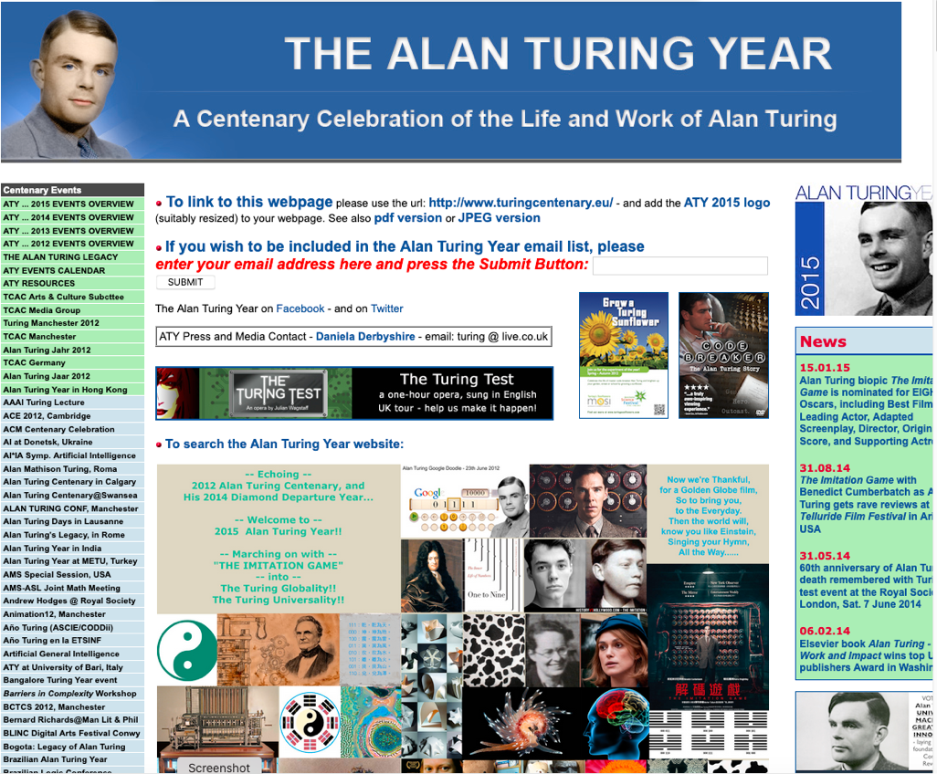
A Story Telling site about Alan Turing
http://www.turingcentenary.eu/

Slide 22
Propositions
A Deep Connection amongst NsM, Data Management, Consensus Algorithms:
Writing Technologies, Accountability and Observability: the nature of data
Paxos/Raft: a class of Consensus Algorithms
Consensus Algorithm provides a tool to define a base vocabulary for a pragmatic context
Abstraction/Concretization <> Control Plane/Data Plane
TLA+ and K-Framework: Abstraction and Meta-Mathematics as Units of Languages
User Interface Design and the nature of “Scalable Consensus”

Slide 23
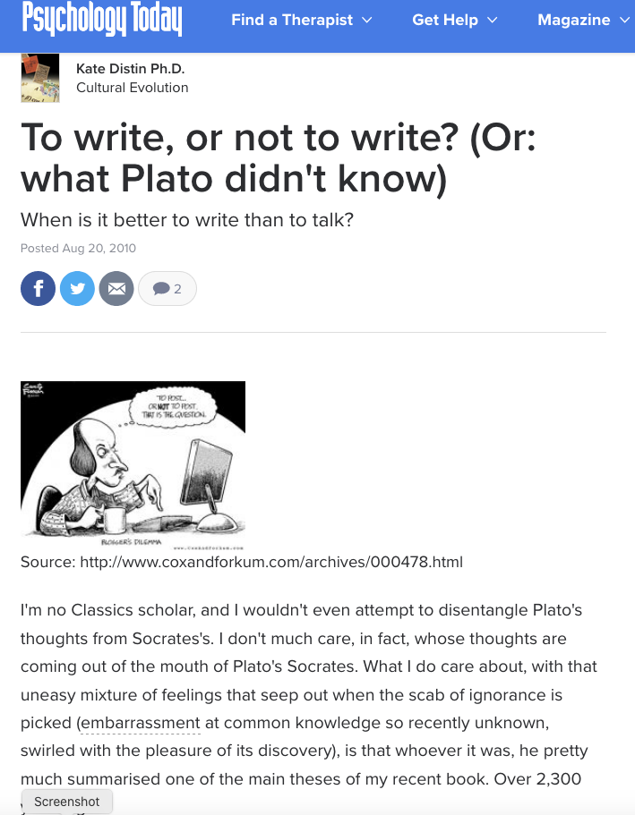
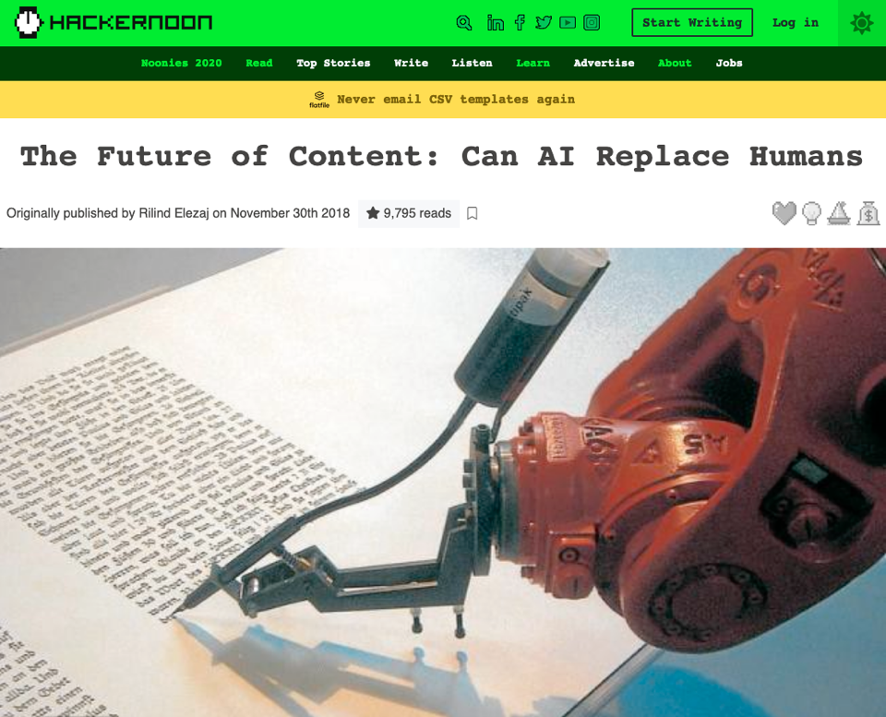
Cognitive Scientists are always struggling with the same question

Slide 24
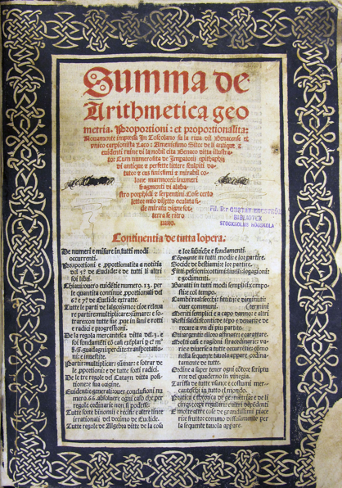
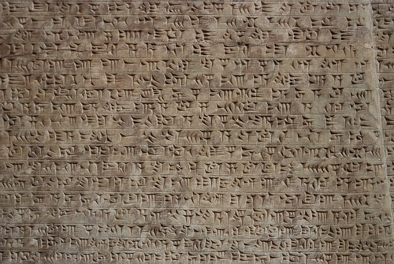
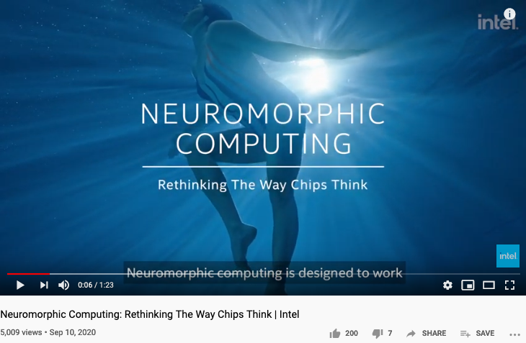
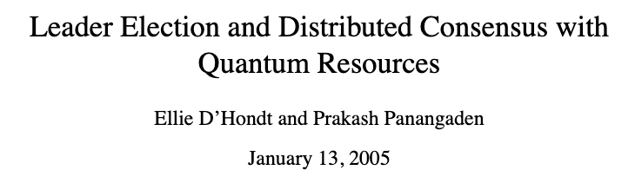

Human invented writing to
keep everyone accountable…
Huawei VP Mr. Yang Shaoqing
“The Sumerians first invented writing as a means of long-distance communication which was necessitated by trade.”
Ancient History Encyclopedia

Slide 25
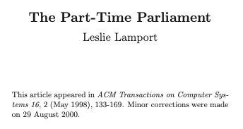
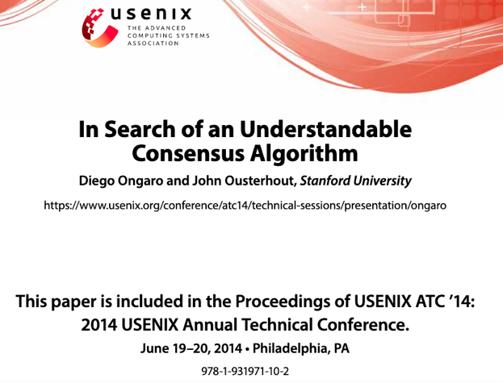
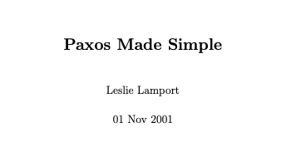
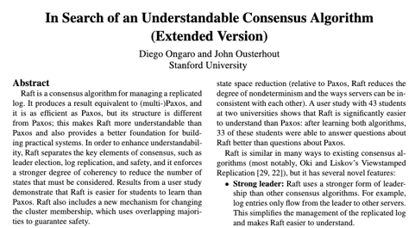
Main Thesis of today’s lecture: “How do you know that you know?” “Writing Technology” being the a way to help reach consensus?
https://raft.github.io/
https://lamport.azurewebsites.net/pubs/pubs.html

Slide 26
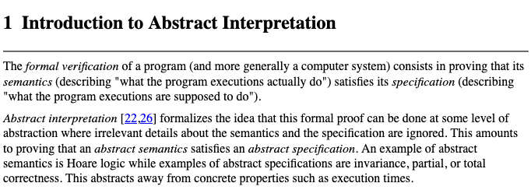
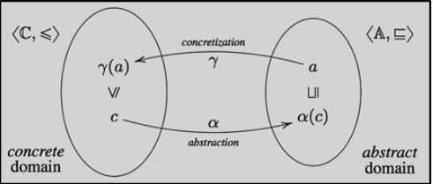

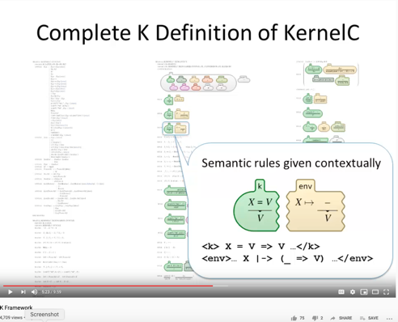
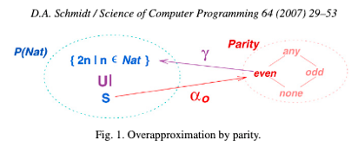
Language Independent Analysis Methods
To ensure universality, one needs to be language/implementation agnostic
https://www.di.ens.fr/~cousot/AI/
Link to a short paper introducing TLA+
Mathematical Abstraction of Temporal Logic
http://www.kframework.org/

Slide 27
A Cognitive Foundation X makes sense in Context Y
Huawei VP Mr. Yang Shaoqing
In a World Y where all things make sense
If you speak the language of X!

Slide 28


The Origin of Writing
Reference provided by Prof. Ray Dougherty
Notes:
In the presentation on Oct-9, 2020, Ray again, stated a link between the Atomic Explosion’s 20 thousands generations of chain reactions and the layers of Syntatic Trees in Chomsky’s Syntactic Theory about language. Then, he also reminded us that Chomsky and Shannon were working in locations that are 100 feet away from each other. The white and black dots are demonstrating the patterns of Fibonacci series.

Slide 29
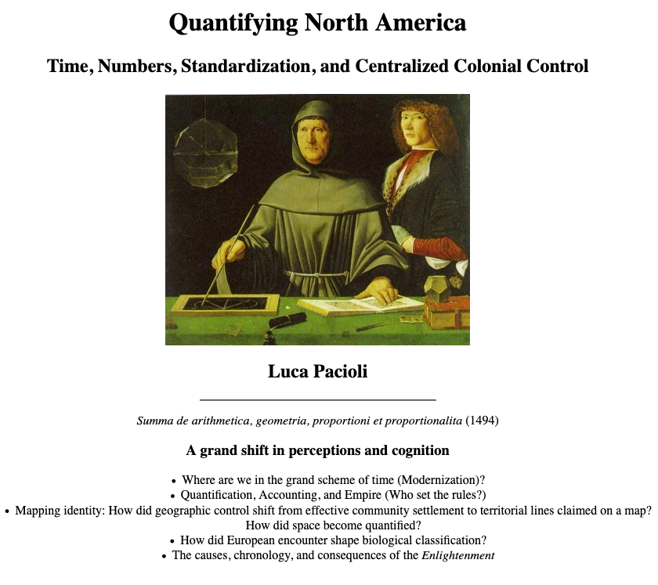
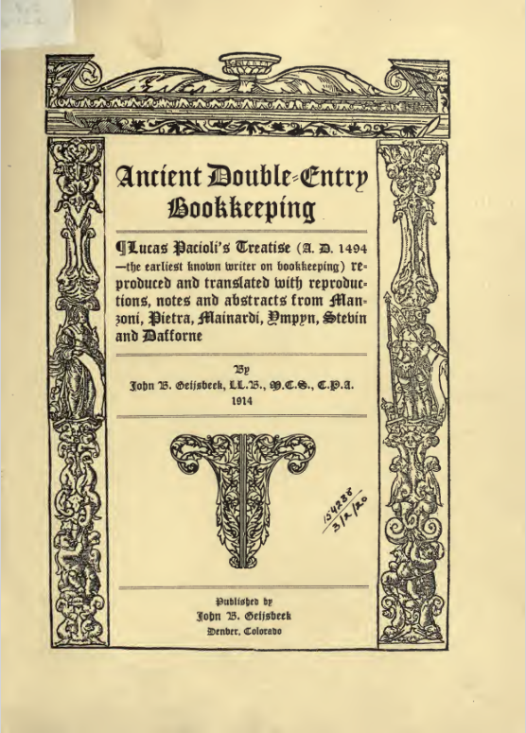
A Cognitive Revolution through writing and mapping
http://history.furman.edu/benson/hst121/show/empiretime.htm
Notes:
In the presentation on Oct-9, 2020, Ray again, stated a link between the Atomic Explosion’s 20 thousands generations of chain reactions and the layers of Syntatic Trees in Chomsky’s Syntactic Theory about language. Then, he also reminded us that Chomsky and Shannon were working in locations that are 100 feet away from each other. The white and black dots are demonstrating the patterns of Fibonacci series.

Slide 30
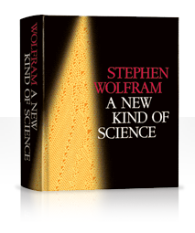
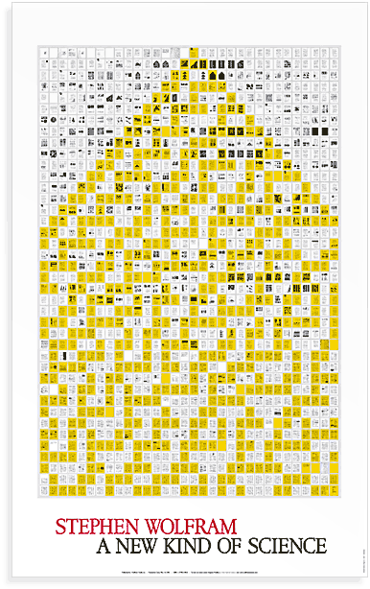
Extensive studies could miss the significance of the message?
The importance is that just by having distinguishable components, either in rules and in observable symbols, it will naturally have Turing completeness.
All computational rules can perform all others. (Curry-Howard Isomorphism)
Oct-9, 2020, Prof. Ray Dougherty
Notes:
In the presentation on Oct-9, 2020, Ray again, stated a link between the Atomic Explosion’s 20 thousands generations of chain reactions and the layers of Syntatic Trees in Chomsky’s Syntactic Theory about language. Then, he also reminded us that Chomsky and Shannon were working in locations that are 100 feet away from each other. The white and black dots are demonstrating the patterns of Fibonacci series.

Slide 31
The first Language Design Strategy
Separate structures from operations!
Prof. Ray Dougherty
Oct-9, 2020
Unary and Universal Arithmetic only needs one symbol and one operation.
For political correctness, maybe use a symmetry-breaking symbol, rather than B/W.
Notes:
In the presentation on Oct-9, 2020, Ray again, stated a link between the Atomic Explosion’s 20 thousands generations of chain reactions and the layers of Syntatic Trees in Chomsky’s Syntactic Theory about language. Then, he also reminded us that Chomsky and Shannon were working in locations that are 100 feet away from each other. The white and black dots are demonstrating the patterns of Fibonacci series.

Slide 32

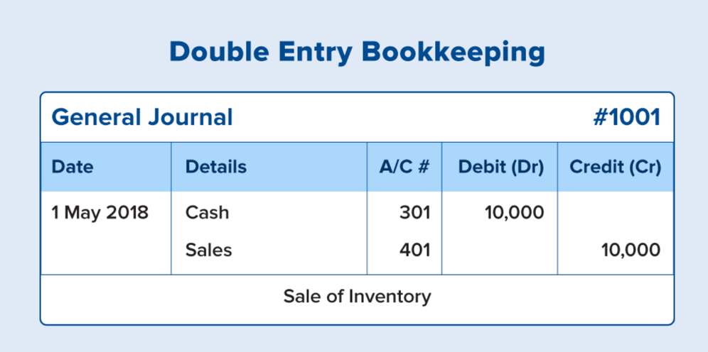
Accountants and the Invention of Writing
Luca Pacioli published 26 pages of account balancing techniques in a math textbook
Accounting Balancing Equation
Asset = Liability + Equity

Slide 33
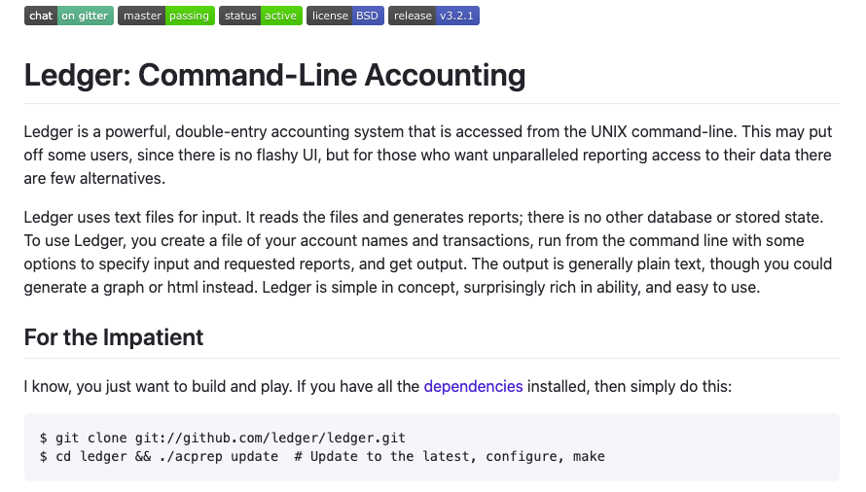
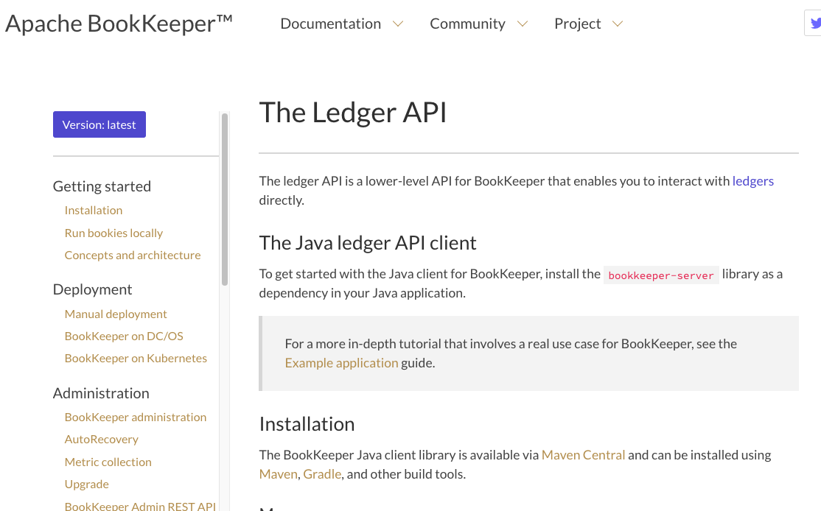
Book Keeping/Ledger Technologies
Notes:
平衡计分卡是从财务、客户、内部运营、学习与成长四个纬度，将组织的战略落实为可操作的衡量指标和目标值的一种新型绩效管理体系。

Slide 34
Double Entry Book Keeping is the foundation of Capitalism
1494年头版，1523年再版
复式记账是Pacioli最著名的科学贡献
Pacioli 是达芬奇的合作伙伴
Summa de arithmetica, geometria, proportioni et proportionalita （算术、几何、比例与可比性之总论）
该书集成了代数、几何、逻辑、计算和记账的内容，包括复利计算等金融学的知识。
是现代科学的奠基之作。
“historian James Aho linked double-entry bookkeeping to the ancient art of rhetoric, … medieval merchants used double-entry bookkeeping as a rhetorical tool of capitalist propaganda, to persuade their ‘audience’ that their business was honest, morally sound and its profit-making ethically justified.”
Excerpt From: Jane Gleeson-White. “Double Entry.”
Notes:
“historian James Aho linked double-entry bookkeeping to the ancient art of rhetoric,”
Excerpt From: Jane Gleeson-White. “Double Entry.” Apple Books.

Slide 35

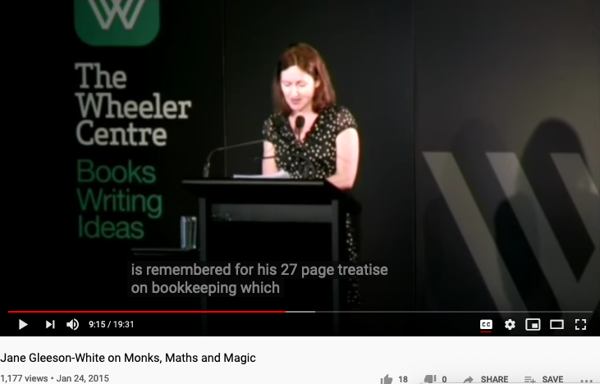
Double Entry, Monks, Maths, and Magic

Slide 36
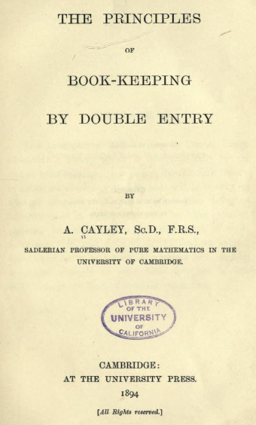
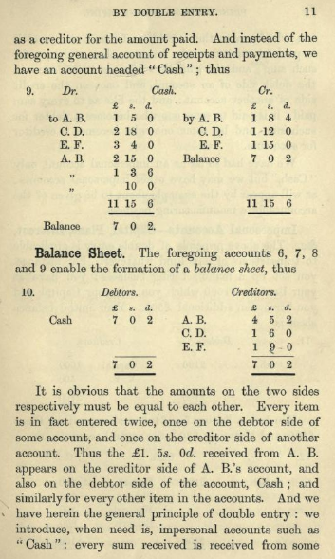
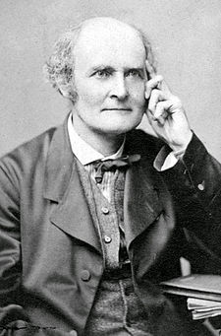
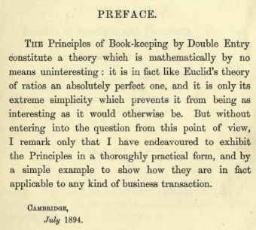
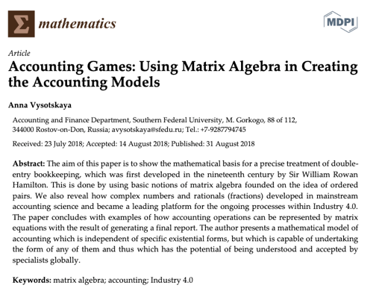
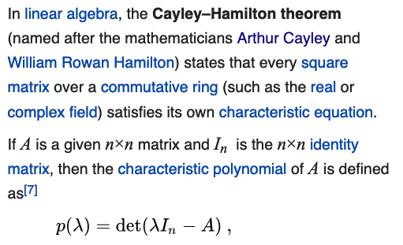
Double Entry Bookkeeping and Linear Algebra
Notes:
“historian James Aho linked double-entry bookkeeping to the ancient art of rhetoric,”
Excerpt From: Jane Gleeson-White. “Double Entry.” Apple Books.

Slide 37
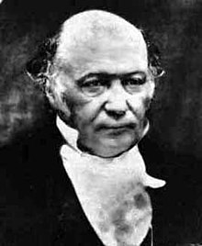
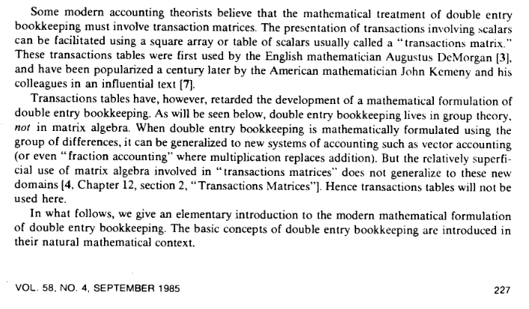
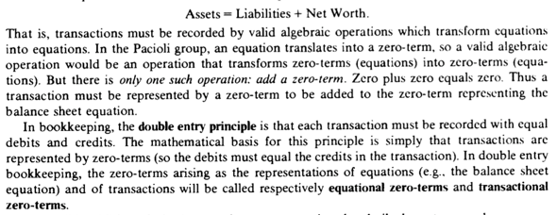
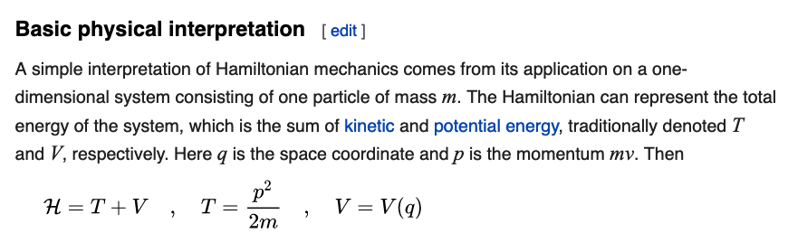
The Accounting Equation and Hamiltonian Mechanics
Accounting Balance Equation:
Assets = Liability + Equity
The structural similarity may seem to be simple in the beginning. But when put them in iterative procedures…
Notes:
“historian James Aho linked double-entry bookkeeping to the ancient art of rhetoric,”
Excerpt From: Jane Gleeson-White. “Double Entry.” Apple Books.

Slide 38

Hamiltonian Mechanics make energy Accountable
Assets = Liability + Equity
and
H = T + V
These two equations basically dominated two fields: Economics and Physical Sciences
Thinking from a Meta-Mathematical viewpoint,
they present a way to break down the total amount of conservative resources,
and therefore, allows iterative branching and therefore continuous replication.
Notes:
“historian James Aho linked double-entry bookkeeping to the ancient art of rhetoric,”
Excerpt From: Jane Gleeson-White. “Double Entry.” Apple Books.

Slide 39
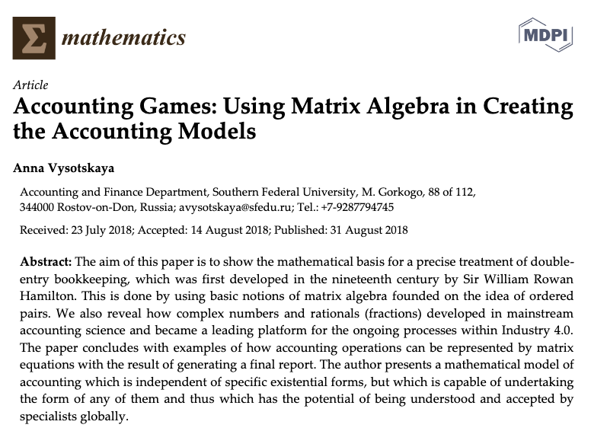

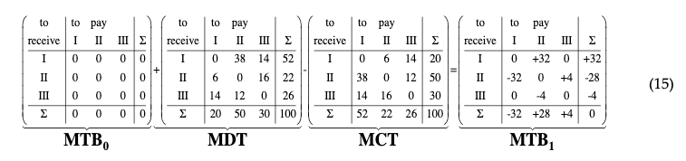
Hamilton did more work on the Accounting Equation
The aim of this paper is to show how the mathematical basis is used for a precise treatment of double-entry bookkeeping, which was firstly developed in the nineteenth century by Sir William Rowan Hamilton. This is done by using basic notions of matrix algebra with the roots to the idea of using ordered pairs. We also reveal how the complex numbers and the rationals (fractions) developed in a mainstream of accounting science and became a leading platform for the ongoing processes within the Industry 4.0.
Image Source: Research Gate
Notes:
In the presentation on Oct-9, 2020, Ray again, stated a link between the Atomic Explosion’s 20 thousands generations of chain reactions and the layers of Syntatic Trees in Chomsky’s Syntactic Theory about language. Then, he also reminded us that Chomsky and Shannon were working in locations that are 100 feet away from each other. The white and black dots are demonstrating the patterns of Fibonacci series.

Slide 40



Kuhn Cycle: recursion and symmetry-breaking
Keeping namespace consistent (is challenging)
Normal Science
Model
Drift
Model Crisis
Model Revolution
Paradigm
Change
Emerging cases or
systematic attacks
Ouroboros Snake
in five named stages

Slide 41
The second Language Design Strategy
combine structure with operations!
The isomorphism between accounting equation and the Hamiltonian formulation states: Science is about utilizing symmetries/invariance recursively.
Put the Accounting /Hamiltonian equation in a matrix structure, the addition operations becomes iterative.

Slide 42

Concrete Activities in Daily Workflow
What is DevSecOps?
Image courtesy: Paladion Corporation Website Image source: https://www.paladion.net

Slide 43
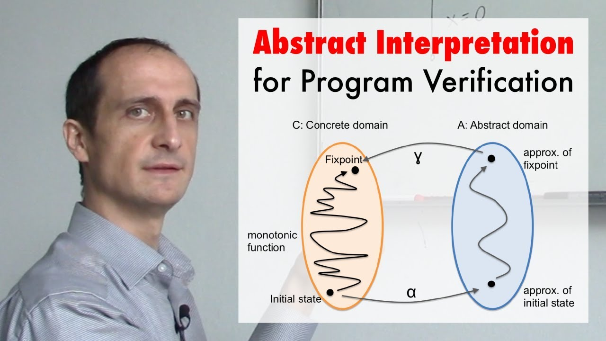
A short introduction video
https://youtu.be/j2m5YMnHvQQ

Slide 44
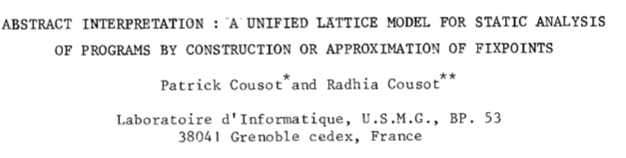

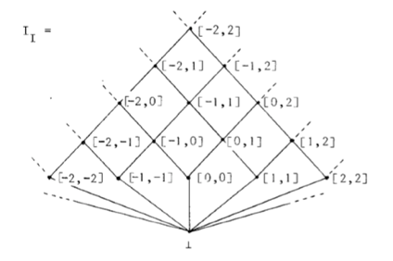
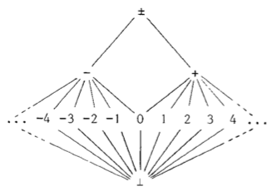
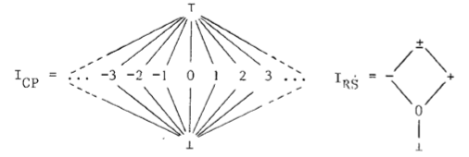
Connecting Abstract and Concrete Domains
4th POPL, pages 238-252, Los Angeles, CA, 1977. ACM Press.
Prof. Cousot and Koo in 2005
Course number: 16.399 Title: Abstract Interpretation Units: H level course, 3-0-9 Lecture hours: Tuesday 11:00–12:30 and Thursday 11:00–12:30 (see the course schedule for exceptions) Location: 33–419 Course web site: http://web.mit.edu/afs/athena.mit.edu/course/16/16.399/www Prerequisites: basic skill in mathematics and experience with computer programming.
Conclusion (the second paragraph)
There is a fundamental unity between all these apparently unrelated program analysis techniques : a new interpretation is given to the program text which allows to build an often implicit system of equations. The problem is either to verify that a solution provided by the user is correct, or to discover or approximate such as solution.
http://web.mit.edu/afs/athena.mit.edu/course/16/16.399/www/

Slide 45
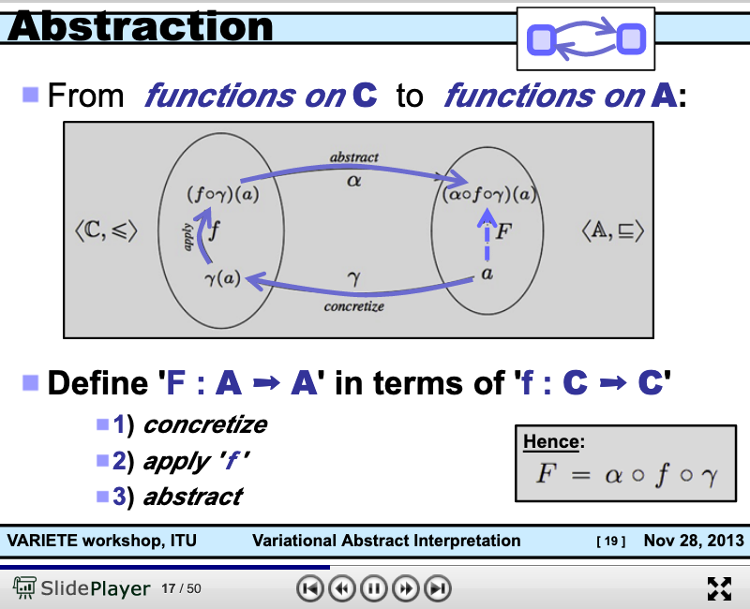
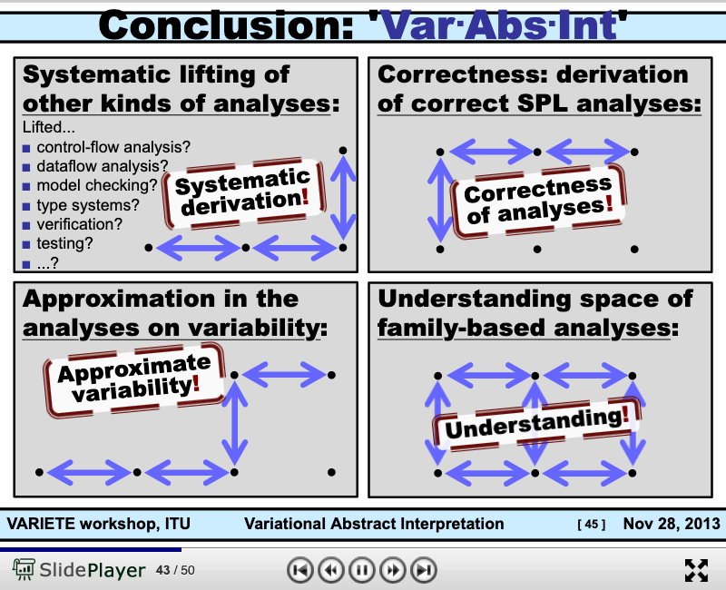
The Basic Working Principle of Composition
https://slideplayer.com/slide/8506871/

Slide 46
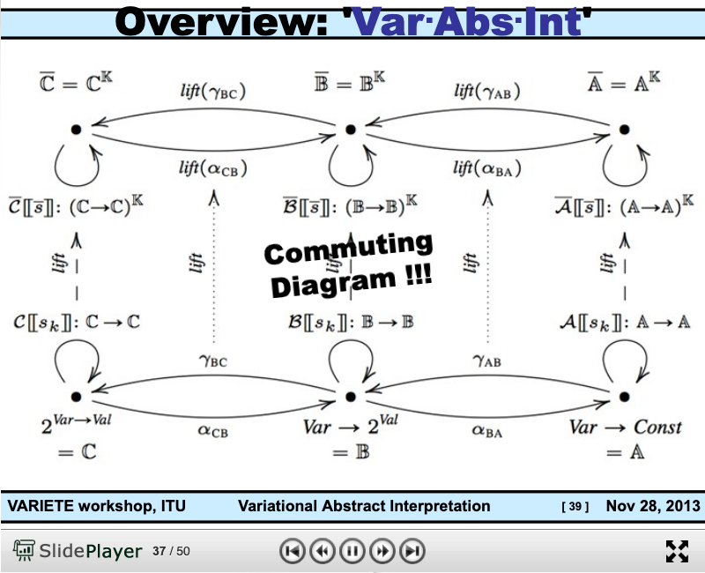
Arrow Chasing Computation
https://slideplayer.com/slide/8506871/

Slide 47
Abstraction
Concretization
Why is abstraction useful?
Allow reuse through universal properties
Avoid resource conflicts
Scale free and domain neutral
Generalizing concrete experience?
Make analogies in localized contexts
Engage sensible metaphors
Define terms and boundaries
A well-defined set of Actions and iterative Branching Strategies
A Roadmap of composable activities
Sequencing and timing conditions
Explicitly state dependencies and resource requirements

Slide 48

In the world of Internet of Things Checks and Balances
Data Plane
Abstraction
Concretization
Control Plane

Slide 49

A New Kind of Operating Systems with built-in Governance
Data Plane

Slide 50

IaaS: Infrastructure as a Service

Slide 51



The Magical Powers of Large-Scale Consensus?
找到了计算信息传递可信度的数学理论
拜占庭将军的问题：提出了分布式数据库的可信度检验算法
http://slideplayer.com/slide/4339032/
https://medium.com/@amuse/how-the-nsa-caught-satoshi-nakamoto-868affcef595

Slide 52



Moore’s Law and the “clockspeed” of Semi Conductor Industry
The number of transistors
packed into a unit space
doubles every 2 years
(some data says 18 months).
The Original Paper: https://newsroom.intel.com/wp-content/uploads/sites/11/2018/05/moores-law-electronics.pdf

Slide 53



Ray Kurzweil’s Version of Moore’s Law

Slide 54

The magic that governs the world for more than 50 years!
西方刘伯温+李淳风+袁天罡
硅谷的烧饼歌/推背图
因特尔创始人摩尔，以科技成熟度的数据为论述，精准地规范了全球产业格局的发展趋势，长达五十年。
以单位购买力计算：2⁵⁰⁼ 1.125* 10^{15 ～}一千万亿倍
https://en.wikipedia.org/wiki/Moore%27s_law

Slide 55


打破认知边界的传奇符咒
系统的两类合约：
安全与活性
Safety: （安全）
Something bad never happens
Liveness: （活性）
Something good eventually happen
The Byzantine Generals Problem * 388
找到了计算信息传递可信度的数学理论
拜占庭将军的问题：提出了分布式数据库的可信度检验算法
http://slideplayer.com/slide/4339032/
ACM Transactions on Programming Languages and Systems, Vol. 4, No. 3, July 1982.

Slide 56




弃婴的魔力改变了记账的方法
A brief history of Spreadsheet
http://www.dssresources.com/history/sshistory.html
Software Arts Corporation
Formed on January 2, 1979
https://en.wikipedia.org/wiki/Moore%27s_law
Image source: https://maaw.info/Chapter2.htm
Notes:
活性，安全性，效率

Slide 57
零交易成本与规模化账本技术催生的新行业
搜寻引擎将自然语言的数据当作数据资产（货币）
谷歌、百度、阿里巴巴、亚马逊、。。。
零交易成本的支付系统
微信、支付宝、Apple Pay，。。。
流媒体和微支付UCG的新类型数据服务
抖音，Steemit，。。。
知识付费的数据资产交易服务
喜马拉雅、得道。。。

Slide 58





平衡账本的策略决定组织的活性与安全性
平衡积分卡让多方利益相关方，
在有共识数据的基础上，创造价值
Image Source: https://www.tutor2u.net/business/reference/balanced-scorecard-introduction-overview
Robert S. Kaplan
2019, Nov. 15
深坑酒店, Shanghai
Notes:
记账成本如何来进行策略决定，组织战略与执行呢？可以参考Robert S. Kaplan的平衡计分卡

Slide 59

区块链平衡了多类型的资源博弈
平衡积分卡让多方利益相关方，
在有共识数据的基础上，创造价值
比特币白皮书
交易所
Satoshi Nakamoto
币圈
区块链
码农
矿场
以太坊
白皮书
Vitalik Buterin
牛顿项目白皮书
徐继哲
Image Source: https://www.tutor2u.net/business/reference/balanced-scorecard-introduction-overview
Notes:
记账成本如何来进行策略决定，组织战略与执行呢？可以参考Robert S. Kaplan的平衡计分卡

Slide 60


平衡积分卡：利益相关方之间的动态平衡
Strategy Map
https://en.wikipedia.org/wiki/Strategy_map
https://maaw.info/ArticleSummaries/ArtSumMartinsonsDavisonTse99.htm
Notes:
平衡计分卡是从财务、客户、内部运营、学习与成长四个纬度，将组织的战略落实为可操作的衡量指标和目标值的一种新型绩效管理体系。

Slide 61

Objective & Key Results (OKRs)
Objectives
A statement of a broad goal,
Usually qualitative in nature.
Key Results
A statement that measures
Achievement of a given objective

Slide 62

Abstraction
Concretization
Why state objectives on paper?
Accentuate objectives in prescribed contexts
Define roles not persons
Objective law enforcement
Why specify key results?
Make explicit targets to orient actions
Assign responsibilities to persons
Fairness in Rewards/Punishment
A well-defined set of Actions and iterative Branching Strategies
A Roadmap of composable activities
Sequencing and timing conditions
Explicitly state dependencies and resource requirements
Namespace (Data Asset) Management

Slide 63
Git Being the Process Organization Model Preserve Event Ordering Information
Normal Science
(commit)
Model
Drift
(build)
Model Crisis
(test)
Model Revolution
(stage)
Paradigm Change
(deploy)
Time Stamp
Time Stamp
Time Stamp
Time Stamp

Slide 64

What is CICD and DevOps? Continuous Integration, Continuous Delivery/Deployment
Image courtesy: Peter Change on Hackernoon

Slide 65

Smart Contract with Observable Historical Data
ISDA: International Swaps and Derivatives Association

Slide 66



GitOps: Git as the Single Source of Truth

Slide 67
Ricardian Contract Socially Binding Digital Twin

Slide 68

A Smarter Smart Contract

Slide 69

Service Mesh (Istio) and Human Phsiology Checks and Balances
Feedback Mechanisms
Command Central

Slide 70


NsM under a Biological/Economic Control System
Image Source: From autopoiesis to neurophenomenology: Francisco Varela's exploration of the biophysics of being,
DAVID RUDRAUF, ANTOINE LUTZ, DIEGO COSMELLI, JEAN-PHILIPPE LACHAUX, and MICHEL LE VAN QUYEN

Slide 71
Abstraction
Concretization
Serve as the Control Plane
Define Policies according to high level objectives
Security roles protected by tech not by political influence only
Law enforcement by controlling targeted resources in the Data Plane
Serve as the Data Plane
Resources governed by Configurable Policies
Security-sensitive infrastructure that assigns traceable responsibilities to persons
Provide feedback from real worlds to reflect on the efficacies of laws
A well-defined set of Actions and iterative Branching Strategies
A Roadmap of composable activities
Sequencing and timing conditions
Explicitly state dependencies and resource requirements
Namespace (Data Asset) Management

Slide 72

Not Information Asymmetry, but promote the Principle of Information Symmetry

Slide 73

Open and then Free
Open Source
Right to use publicly available technologies and other resources in the learning process
Right to resolve conflicts in a dynamic context in digitized space
Freedom to make decisions related to one’s personal digital assets
Freedom to express one’s opinions
Free Software
Founder of Free Software Foundation, and Creator of GNU/Linux. Image credit: Wikipedia
Paraphrased from “Free Software, Free Society” by Richard Stallman

Slide 74




Participation Model and Data Agencies
New Narrative for AI/XI
Free Will at all levels and scales of society
Metrics for Success
Reclaim Rights to Digital ID
Observability/Data Immutability. Data Presentation Tech
Affordable Personal Security (OpenID/Kerberos)
Anonymous Network (Dark Net)

Slide 75





Cybernetics and the Social Behavioral Science

Slide 76


Cybernetics: Communication and Control
Image Source: Intro to System Science and Cybernetics,
Dr Paul Pangaro
There is a strong connection between control/communication theory and recursive structures.

Slide 77



Correspondence between Domains and Maps

Slide 78


Where is Paxos?

Slide 79


Simplicity in NsM is Strategic!
The Named Roles in Paxos/Raft
Proposers to present changes
Learners to Authorize
Learner to Execute
Governance Tools
Holacracy
Hypha-Decentralized Human Organization
Image Source: An Overview of Consensus Algorithms, by DxChain
Image Source: Hypha Project, by Hypha Earth

Slide 80

Paxos Visualized

Slide 81


A Talk on the subject of Paxos

Slide 82


A Talk on the subject of Raft

Slide 83

Kubernetes/ETCD and Raft
Notice that Kubernetes is the original form of Cybernetics.

Slide 84


Namespace Management in Time

Slide 85



The notion of Symmetry/Symmetry-breaking
Find a video or image showing the Trust-worthy Book Keeping comes from Symmetry and Symmetry-Breaking!

Slide 86

A Common Trick in Data Verification
Double Entry Ledger is a mechanism to leverage closure properties to verify data!
Double Entry Book Keeping was used as an example to explain the power of Symmetry/Invariance properties in Mathematics, not the only application
All fields of sciences and maths are grounded on invariance somehow.
“the root of all symmetry principles lies in the assumption that it is impossible to observe certain basic quantities” (p. 178 of Particle Physics and Introduction to Field Theory, New York: Harwood Academic Publishers.)
https://plato.stanford.edu/entries/weyl/

Slide 87
Why is Simplicity in NsM so Strategic
Controlled Entropy = Controlled Time
Think about Google’s interface
Why are they removing buttons on iPhone?
Bound Variables in Logics
When complexity is inevitable
Leverage the notion of symmetry
See Hermann Weyl’s quote on lacking information…
Image Source: Intro to System Science and Cybernetics,
Dr Paul Pangaro

Slide 88

Abstraction
Concretization
Motivation
Symmetry over all spacetime
Only encode patterns
Self-contained yet Transcendental
Definition
Local context breaks symmetry
Patterns requires cognitive efforts
Influenced by external factors
A well-defined set of Actions and iterative Branching Strategies
A Roadmap of composable activities
Sequencing and timing conditions
Explicitly state dependencies and resource requirements
Namespace Management

Slide 89



区块链：赋予数据物理意义的可信计算技术
空间数据覆盖面
区块链：一种基于不直接相关
的交易事件公证日志（时钟）
物联网
物联网：铺天盖地的传感器网络
通过物理现象的共识产生可信数据
时间数据链条
Notes:
这就回到当时的区块链了，为什么我们要大力发展区块链、物联网？因为区块链和物联网给数据资产的度量衡提供了时间、空间的可观测数据进而让我们建立了可信机制

Slide 90



空间网 Web 3.0 = 对数据赋予时间与空间的标示
XR is a decentralized network protocol that transforms our Web physical space into a secure, encrypted three-dimensional web space where content and applications can be projected, viewed, and transmitted. XR Web creates the basic infrastructure and SDK where various applications can be created, such as XR gaming, social media, real estate, advertising, trip sharing, home sharing, retail insurance.
Image credits: https://www.xrweb.network/
Notes:
下面我们再引入以下空间网的概念，空间网=对数据赋予时间与空间的标示

Slide 91
空间网 Spatial Web = 对数据赋予时间与空间的标示
产业运营的智能化、来自具有物理意义的数据内容
Image credits: http://verses.io
Image credits: http://verses.io
全球物流的数据服务
从矿产开发开始
Image credits: http://verses.io
Image credits: http://verses.io
Notes:
这几张图可以对空间网的概念有大致的了解认知

Slide 92

区块链是一个分布于全球范围的社群账本
对数据内容赋予时间共识（物理意义）
Nick Grossman: https://www.nickgrossman.is/2015/the-blockchain-as-time/
Notes:
在时间上，我们把区块链定义成是一个分布于全球范围的数字时钟，他可以对数据内容赋予一个时间上的标识即打上时间戳。时间问题得以解决。

Slide 93



区块链的设想： 规模化备份的滚动数据，提高被任意篡改的困难度， 从而提高可信程度
可信度
（规模:参与者的数量）
时间
空间
Notes:
那么当区块链的参与者越多也代表着交易链越长，计算力越高那么这个模型就可以对区块链进行初步理解，后续的时间、空间问题会在后面的PPT中逐一解决。

Slide 94


芝加哥学派的新范式：当记账成本低于生产成本
Image Source:
P 123 of Code V2 by L. Lessig
Notes:
由上，我们当前的经济其实是“账户经济”，倘若记账成本低于生产成本？那么记账就是最简单最盈利的事情了

Slide 95


账户经济是加速扩张的经济形态
http://dushuren123.com/bookmov/video/share.jsp?id=648112690
Notes:
因为这前五大、二十大的上市公司是管理数据的数据公司，所以管理数据的他们最有钱。
引用Peter Bakker的话“科学家不能改变世界，但会计师可以。”
上述的那些公司就是数据的会计师公司，现在我们所在的时代是数据资产时代，我们的所有资产都在账户之中。谁管理我们的账户，那么谁就是会计师。

Slide 96
交易成本与测试成本的关联
以大学入学为例：
大学的筛选过程，可以是非常繁琐的面试与笔试程序
筛选程序繁琐，可以比喻为交易成本高
繁琐的筛选程序，不见得筛选出特别好的学生
低价的测试手段，也可能辨识出学生的好坏
同样的筛选资源，辨识效率高的程序，是一种生产力
区块链提供了一种辨识真伪效率高的技术平台
有效测试好比一个非常高效率(眼光精准)的麦克斯韦妖

Slide 97


账本技术加速了社会技术的发展
账本技术的规模化
催生规模化的社会技术
新社会技术带来的新生产力可能带来爆炸性的财富增长
社会技术中的关键功能：
协调前提：建立共识（账本）
和平、爱与理解：女性力量（利他）
组织进化：迭代的可观测性

Slide 98
区块链的多层次安全性
个别账户：密码的私密性与破解难度
通过密码保护账户内资产支配的权力
代码： 交易合约的公正性
通过开源社区的代码公开检验机制
记账群体：全体参加记账群体的资源总量
通过资源的投入量决定安全性
能源消耗、计算机与存储器材、运维人员。。。
(PoW，PoS, …)

Slide 99
区块链的活性指标
特定时段发生交易的账户数：（日活量， Daily Active User）
账本更新的活跃程度
度量社群的“活性”Liveness
单位时间可完成交易的次数： Transaction Per Second (TPS)
网络数据系统的技术性指标：高性能系统可达 1 M+ TPS
目前比特币大约 7 TPS
目前以太坊公链大约 20 TPS
均不适合担任一般日常经济活动的交易平台
绝大部分的市场交易发生在第三方（中心化）的交易所

Slide 100



Code is Law

Slide 101

A Unified Context for the Collective Cognizance
Far
Space
near
before Time after

Slide 102

根据时空特性分类的治理决策平衡手段
市场
远
空间
近
架构
执法
前 时间 后
常态
Image Source: page 123 of Code V2 by L. Lessig
Notes:
我们这一套体系最基础的模型就是基于芝加哥学派所划出的产业发展四力模型而出的。

Slide 103

Lecture Outline

Slide 104

Arts and Sciences of NsM
History of Names
Patterns of Names
Trust-worthy Names
Namespace management is the Cognitive Foundation.

Slide 105


The Meaning of being True
Huawei VP Mr. Yang Shaoqing
RICH 70 Tsinghua SEA Cloud Forum, Sep 14, 2020
H. E. Bambang Brodjonegoro,
Minister of Research & Technology, Indonesia
Russel once said: “Mathematicians’ job is about classifiying.”
Mathematics is the art of giving the same name to different things.^{[10]} Henri Poincaré

Slide 106

How to Think Mathematically?
Huawei VP Mr. Yang Shaoqing
RICH 70 Tsinghua SEA Cloud Forum, Sep 14, 2020
H. E. Bambang Brodjonegoro,
Minister of Research & Technology, Indonesia
Russel once said: “Mathematicians’ job is about classifiying.”
Mathematics is the art of giving the same name to different things.^{[10]} Henri Poincaré

Slide 107



“Mathematics is the art of giving the same name to different things!” - Henry Poincare

Slide 108


The Necessity of Named abstractions
Huawei VP Mr. Yang Shaoqing
Through abstraction, only compute truth within the domain of interest!
So that it can by pass the Halting Problem.

Slide 109



How to Reason about Namespace Rigorously?
Huawei VP Mr. Yang Shaoqing
The K Framework & Formal Verification Efforts in the Blockchain Space
By Ola Kohut
RICH 70 Tsinghua SEA Cloud Forum, Sep 14, 2020
H. E. Bambang Brodjonegoro,
Minister of Research & Technology, Indonesia

Slide 110


Approximate Truth through Multiple Abstractions
Look into Abstract Interpretation by Patrick and Radhia Cousot
The invention of Widening and Narrowing Operators
Known in the area known as Static Analysis

Slide 111

NsM at Scale!
Relations on the Web
URL: Universal Resource Locator
Universal Data Formats
Physical Objects connected through Namespaces

Slide 112





Namespace Management on the Global Scale
Berners-Lee called his vision for the web “utopian.”
He wanted it to be a place where all people had access to the best information at any time.

Slide 113


Paxos and Raft for Collective Consciousness
Namespace = Cognitive Space

Slide 114



Name Namespaces of Paxo and Raft
Paxos Roles:
Client
Proposer
Voter (Acceptor)
Learner
Leader

Slide 115

Think of Service DevOps
Traders/Hunters
（students/teachers）
Miners/Herders
（Administrators/Witnesses）
Coders/DNA Editors
(Artists/Creative People)
p.39 of ITIL for Dummies
By Peter Fareden

Slide 116


Service Evolution in the Abstract
p.188 of ITIL for Dummies
By Peter Fareden
p.202 of ITIL for Dummies
By Peter Fareden

Slide 117

Comparing Paxos and Raft

Slide 118
Abstraction
Concretization
Safety
Nothing
bad happens
Liveness
Some
Good Things
Must Happen
A well-defined set of Actions and iterative Branching Strategies
A Roadmap of composable activities
Sequencing and timing conditions
Explicitly state dependencies and resource requirements
Correctness

Slide 119
Iteratively Fixing Security Problems
Technology Integration
Technology
Society
Security
Technology
Security
Society
Technology Isolation
Modified from Figure 1-1 and 1-2 of Agile Application Security: Enabling Security in a Continuous Deliver Pipeline,
by Laura Bell, Michael Brunton-Spall, Rich Smith & Jim Bird, O’Reilly Media, 2017

Slide 120



The Version Control, Built, Test, Stage, Deploy are Conducted by Human Instructions
Think of a multi-staged snake…
Image courtesy: Learn How to Set Up a CI/CD Pipeline From Scratch on DevOps Zone

Slide 121
A compositional view of system correctness
Liveness
Safety
Correctness
The Theoretical Definition of System Correctness
Correctness = Liveness ∧ Safety
Liveness: Something good eventually happens
Safety: Nothing bad ever happens

Slide 122

The Commit-Built-Test-Stage-Deploy are Fully Automated
Image courtesy: Learn How to Set Up a CI/CD Pipeline From Scratch from DevOps Zone

Slide 123
Continuously Adjust the Correctness Area
Liveness
Safety
Correctness
The Inremental Change Approach promoted by DevOps/CICD practitioners

Slide 124

Cognitive Awareness in Various Namespaces
Abstract Specification
Concrete implementation
Time Scales
Control Plane
Data Plane

Slide 125


The CAP Theorem in NsM
RICH 70 Tsinghua SEA Cloud Forum, Sep 14, 2020
H. E. Bambang Brodjonegoro,
Minister of Research & Technology, Indonesia

Slide 126
Abstraction
Concretization
Choose a namespace (language)
Given resource bounds, satisfy functional soundness and completeness
Specify what is safe
Specify what is alive
Create the namespace (language)
Use TLA+ and K-framework to ensure satisfaction
Reason about safety via static analysis
Assess liveness via dynamic analysis (execute test runs)
A well-defined set of Actions and iterative Branching Strategies
A Roadmap of composable activities
Sequencing and timing conditions
Explicitly state dependencies and resource requirements

Slide 127

Abstract Specification
Concrete Implementation
A well-defined set of Actions and iterative Branching Strategies
A Roadmap of composable activities
Sequencing and timing conditions
Explicitly state dependencies and resource requirements
Namespace Management

Slide 128


Cybernetics at a Scale of Internet Economy

Slide 129

The Service Value Chain of the Networked Economy

Slide 130

SLA, OLA, and UC
Acronyms
SLA: Service Level Agreement
OLA: Operational Level Agreement
UC: Underpinning Contracts
ITIL (IT Infrastructure Library)
Namespace management for IT services
A new industry standards body

Slide 131


Abstract Specification Format IT Service Management through SLA

Slide 132


Concrete Implementation ITIL: Accounting System for Safety and Liveness
RICH 70 Tsinghua SEA Cloud Forum, Sep 14, 2020
H. E. Bambang Brodjonegoro,
Minister of Research & Technology, Indonesia
p.33 of ITIL for Dummies
By Peter Fareden
p.97 of Effective IT Service Management to ITIL and Beyond
By Rob Addy

Slide 133

ITIL’s Service Classification
Image Source: ITIL for Dummies P.74
The Cabinet Office refers to UK’s Cabinet.

Slide 134

Types of Digital Assets
Asset Container | Operations | Tools
File(Document) | Content Editing | MediaWiki
File Directories | Changing File Structures | Git
Micro Services | Execute Programs | Docker
Configuration Data | Deployment & Maintenance | Kubernetes
Physical Environment | Physical Actions | Hackerspaces

Slide 135

Digital Tools in Software Containers

Slide 136













Computing Architectures associated with Tools
Abstract Specification
Cloud Computing
Deterministic
Probabilistic
Centralized
Hybrid
Distributed
Single/Multi Core
Many Core
Single Site
Multi Site
Many Site
Hackerspaces
Super Computing Center
Notes:
136

Slide 137

Why is this a big deal?
With data content becomes
Trust-worthy, Provably correct (TLA+)
Privately searchable (Elastic Search)
Tailored for personal use
A publicly admitted pricing system
Account Management
Privacy Protection

Slide 138





You are in the Universal Namespace, now!
Library of
Linked Knowledge
(Data Plane)
Library of Executable Algorithms
(Control Plane)

Slide 139








How to organize a unifying Trust-worthy Namespace?
Ground in arithmetic rules (Gödel Numbering)
Organize knowledge in terms of Meta-Mathematics
Store content in Distributed Hyperlinked Databases

Slide 140

In DevOps/CICD Jenkins holds the key!
Jenkins enables all system-level actions to be triggered with properly assigned names.

Slide 141

Jenkins actions are managed in the Namespaces of Plug-ins

Slide 142


Hamilton/Lagrangian action formalism can be operationalized!
Jenkins enables all system actions to be triggered with properly assigned names.
Automation provided by Jenkins could be subsumed by the action formalism invented by Lagrange and Hamlilton.

Slide 143


Writing everything in Arrows
https://slideplayer.com/slide/8506871/

Slide 144

Computers doing all the writing and rewriting…

Slide 145
Summary
Writing (Data recording) enables accountability
Create collective consciousness across spacetime
NsM reasoning through Abstract Interpretation and K-Framework
Temporal Reasoning using TLA+,
Written records became valuable through Namespace Management (NsM)
Generic Consensus Algorithms enable distributed processes to effectively accountable
NsM is achieved through Proposal -> Learning -> Syncing -> Expiring cycles
Use a unifying Abstraction to separate Structures from Processes
Concrete Data values are captured using scalable IT infrastructures
Generic writing and accounting system as Knowledge Management Standards (ITIL)

Slide 146
Your actions before Oct 19, 2020
Start using Templates and Categories on toyhouse.wiki:81
Create a page about your project, using standardized Templates and Category
Make sure all Wiki pages you created follow the same Namespace convention
Start using Github to download and share files with proper NsM
Couse Github @ https://github.com/benkoo/CognitiveFoundation2020
Start writing your learning report.
Every week should include Logic Model using the standard Template
500 words or more per week

Slide 147


A Pioneering book in Transdisciplinary Studies

Slide 148

Table of Content

